Slide 1
Addressing Recent Global Issues with Taylor Rules:
Measuring R* and the Real Exchange Rate
international sector
George Dimopoulos, Evian Jiang, Rhea Kale,
Melissa Khasbagan, Conner Maurer
ECON 101
June 2024

Slide 2





Introduction
R* is the real short-term interest rate expected to prevail when an economy is at full strength and inflation is stable.
Since the pandemic, debate on the natural rate of interest (R*) has reignited. It is a vital component for determining monetary policy.
How does R* vary across different countries? How can we accurately estimate it to arrive at a more effective monetary policy?
Our project applies the Taylor Rule to four different economies (US, UK, Euro, Japan) to estimate R* and improve the Taylor Rule’s international applicability by considering the addition of the real exchange rate.
Notes:
Rhea
https://www.ft.com/content/e0f27da0-b735-4b73-b5a9-06dbc186842f

Slide 3
Roadmap
Literature review
Our project and scope
Data
Methodology
Results
Conclusion
Notes:
The Roadmap of the Presentation is as follows
Talking about the literature that was used
Then talk about our research and scope
Data that was used
Methodology of the regressions
Results
And the conclusion

Slide 4
Literature Review
1. Estimating R*
2. Modifications to the Taylor Rule
Current literature includes:
Laubach and Williams (LW) model (2003)
Estimates R* using data on real GDP, inflation, and FFR for the US
Holston, Laubach, and Williams (HLW) model (2017)
Extends LW model by incorporating international data on the US, Canada, and Euro Area
Holston, Laubach, and Williams (HLW) model (2023)
Considers time varying volatility and persistent supply shocks (e.g., pandemic)
Taylor Rule
Intercept of the Taylor Rule suggests R* of 2%
Current literature includes:
“The Taylor Principles” by Nikolsko-Rzhevskyy, Papell, and Prodan
Explore various modifications to the Taylor Rule, such as time-varying equilibrium real interest rates
Provides quantitative method for understanding Taylor Rule deviations
“Taylor Rules and the Deutschmark–Dollar Real Exchange Rate” by Engel and West
Explores the relationship between the Taylor Rule and real exchange rates
Highlights international applicability of Taylor Rule
Takeaway: There is a significant variation in R*, from 0.5% to 2%
Contribution: We aim to contribute to this discourse by measuring R* ourselves
Takeaway: Methodology from Nikolsko-Rzhevskyy, Papell, and Prodan for modifying Taylor Rule
Contribution: Gap in considering correlation of exchange rate with output gap and inflation
Notes:
Rhea
https://www.newyorkfed.org/research/policy/rstar
https://www.sciencedirect.com/science/article/pii/S016407041930028X
https://www.nber.org/system/files/working_papers/w10995/w10995.pdf

Slide 5
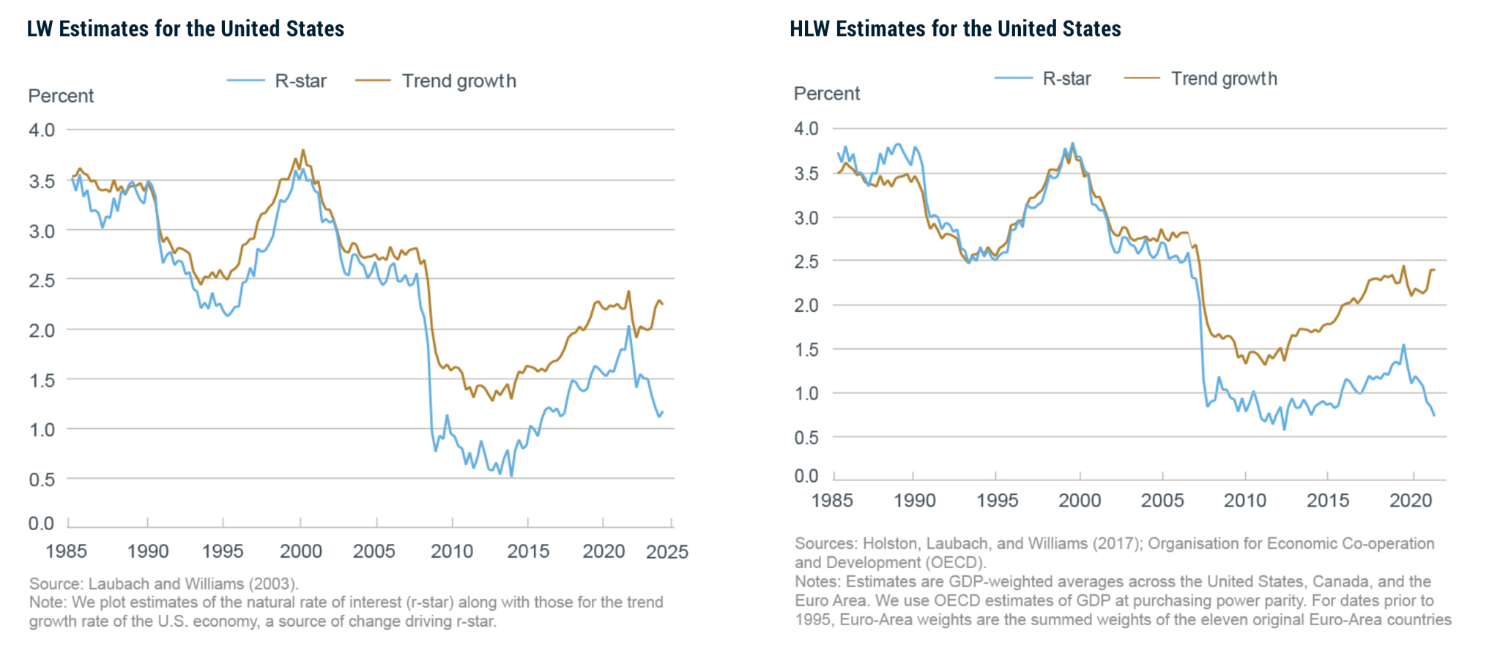
Variation in R*
Notes:
Rhea
https://www.newyorkfed.org/research/policy/rstar

Slide 6
Literature Review
1. Estimating R*
2. Modifications to the Taylor Rule
Current literature includes:
Lobach and Williams (LW) model (2003)
Estimates R* using data on real GDP, inflation, and FFR for the US
Holston, Laubach, and Williams (HLW) model (2017)
Extends LW model by incorporating international data on the US, Canada, and Euro Area
Holston, Laubach, and Williams (HLW) model (2023)
Considers time varying volatility and persistent supply shocks (e.g., pandemic)
Taylor Rule
Intercept of the Taylor Rule suggests R* of 2%
Current literature includes:
“The Taylor Principles” by Nikolsko-Rzhevskyy, Papell, and Prodan
Explore various modifications to the Taylor Rule, such as time-varying equilibrium real interest rates
Provides quantitative method for understanding Taylor Rule deviations
“Taylor Rules and the Deutschmark–Dollar Real Exchange Rate” by Engel and West
Explores the relationship between the Taylor Rule and real exchange rates
Highlights international applicability of Taylor Rule
Takeaway: There is a significant variation in R*, from 0.5% to 2%
Contribution: We aim to contribute to this discourse by measuring R* ourselves
Takeaway: Methodology from Nikolsko-Rzhevskyy, Papell, and Prodan for modifying Taylor Rule
Contribution: Gap in considering correlation of exchange rate with output gap and inflation
Notes:
Rhea
https://www.sciencedirect.com/science/article/pii/S016407041930028X
https://www.nber.org/system/files/working_papers/w10995/w10995.pdf

Slide 7
Literature Review
3. International applications of Taylor Rules
4. Significance of real exchange rate
Current literature includes:
El-Shagi and Ma’s “Taylor rules around the world: Mapping monetary policy”
Importance of Taylor Rules as a standardized framework for inflation targeting.
Teryoshin’s “Historical Performance of Rule-Like Monetary Policy”
There is greater economic stability with Taylor rule-like policies.
Current literature includes:
“The real exchange rate in Taylor rules: A Re-Assessment” by Richard Froyen and Alfred Guender
Exchange rates improved accuracy
Supports target inflation
Accounts for international fluctuations
Takeaway: Standardization of monetary policy rules
Promotes stability
Promotes Cooperation
Contribution: Standardizing our data set to get better results
Takeaway:
Less Aggressive Optimal Policy
Include in the Regressions
Contribution: We aim to contribute to this discourse by measuring R* ourselves
Notes:
International Applications of Taylor Rules
El Shagi and Ma’s research
This found the importance of Taylor Rules as a standardized framework for inflation targeting.
In Teryoshin’s research
It highlights greater economic stability with Taylor rule-like policies.
Exemplifying the need to follow Taylor-Rules
Our large takeaway is necessity of standardization of monetary policy rules across different economies
to promote stability, facilitating comparisons and fostering cooperation
The key findings of applying the Real Exchange Rate:
Adding in the real exchange rate was found to:
Improving accuracy favoring a less aggressive approach to policy making
It supports inflation targeting
It also accounts for international fluctuations, ensuring that policies are responsive and effective
Enhances the monetary policy effectiveness, making it essential to apply to our regressions

Slide 8
Our project and scope
Our project addresses recent issues with the Taylor Rule for estimating R* at a globally-applicable level by using international data to compute measures for R* and evaluate the value of adding the real exchange rate
Part I: Estimating R*
Given the recent debate on R*, how can we effectively measure and estimate R* for the US and internationally?
We use a simple, inertial, and rolling regression to estimate R* for the US in different time periods as well as internationally.
Part II: Significance of the real exchange rate
Does the real exchange rate add significant value when formulating monetary policy using Taylor Rules?
We regress real exchange rate with output gap and inflation to assess whether it is useful to modify the Taylor Rule with the exchange rate.
Notes:
Rhea
Our project ultimately aspires to enhance the understanding of R* and its determinants in order to equip policymakers across the world with improved tools when implementing monetary policy.

Slide 9
Data
Inputs - shadow rate, inflation (CPI), output gap (real GDP-real potential gdp)/ potential real gdp), exchange rate (real narrow exchange rate)
Data Sources
St. Louis FRED and compiled it into a single file for each country/region
Had enough data to start from 1985 annually
If FRED did not have, found from Bank of England, European Commission, IMF shadow rates
Shadow rate vs. federal funds rate
When federal funds rate was nearing 0, used shadow rates instead
Wu-Xia (2016) approach
Notes:
Was trying to do annually then ran into data issues

Slide 10
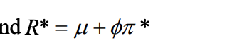
Methodology: U.S.
Where:
R* = equilibrium level of real interest rate
𝓜= Intercept
ɸ = Inflation Coefficient - 1
𝝅 = target inflation (2%)
Non-Inertial Regression
Inertial Regression
Notes:
R* dr. boul and coatuhors taylor principles 2019
For three periods, 1985-2019, 1985-2007, 2009-2019
Simple regression; Look at inflation and output gap impact on interest rate
Rolling, ran the same simple regression for every 40 quarters/about 10 years, to generate R* over the entire period
Then inertial
Inertial = fed reacting slowly or with a lag - inertial provides a better fit for the FFR; more realistic of how the Fed would act
Inertial may work better because more accurate interpretation of the FFR
Adding smoothing coefficient may allow for a more accurate interpretation
hypothesize that R* will be lower if not negative from 2009 to 2019 due to the impact of the great recession and deflationary pressures, and likely positive prior, and after this period, especially with inflationary pressures associated with coivd

Slide 11
Methodology: International
Where:
R* = equilibrium real interest rate
𝓜= Intercept
ɸ = Inflation Intercept - 1
𝝅 = target inflation (2%)
Non-Inertial International Regressions
Inertial International Regression
Notes:
Same R*, on the entire dataset
For int’l, we ran the same regression as we did on the US sample, then added the real exchange rate to run another regression
Inertial

Slide 12
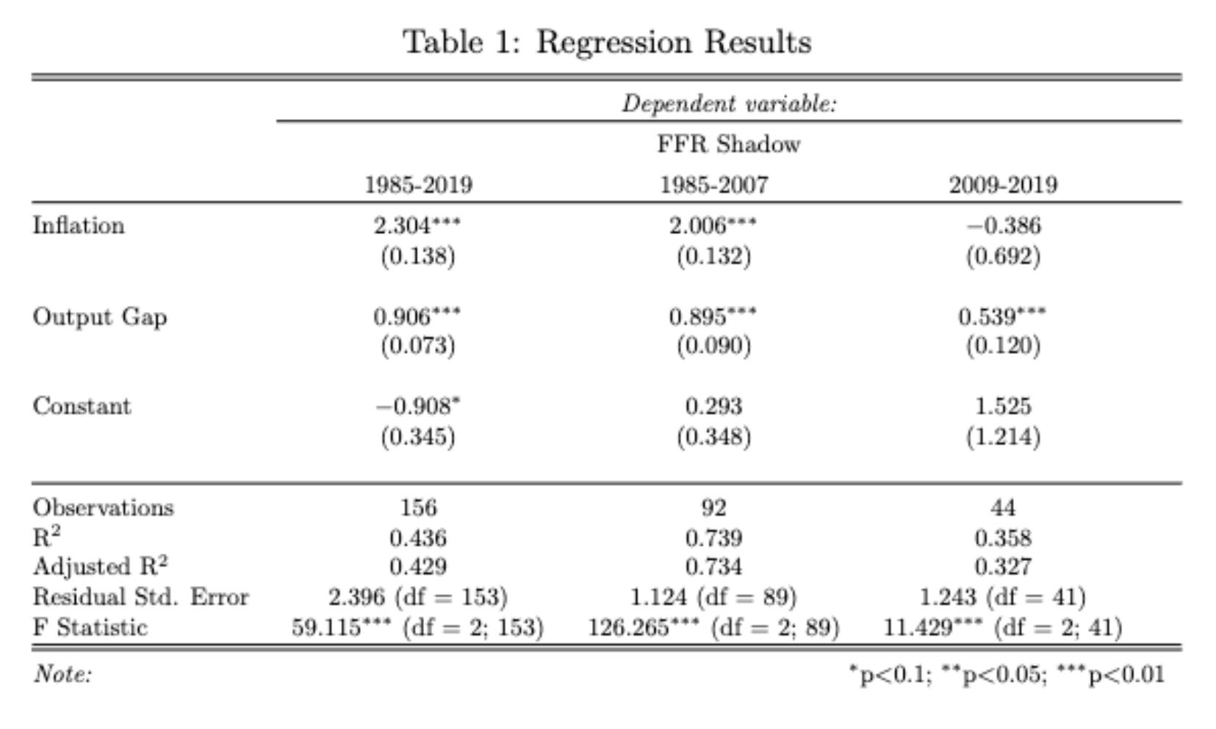
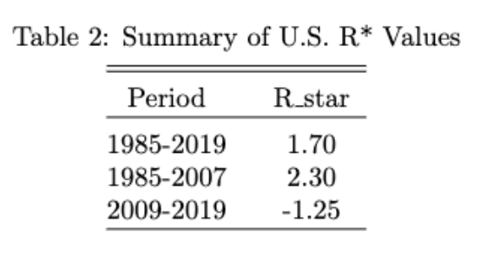
US Results: Simple Regression

Slide 13
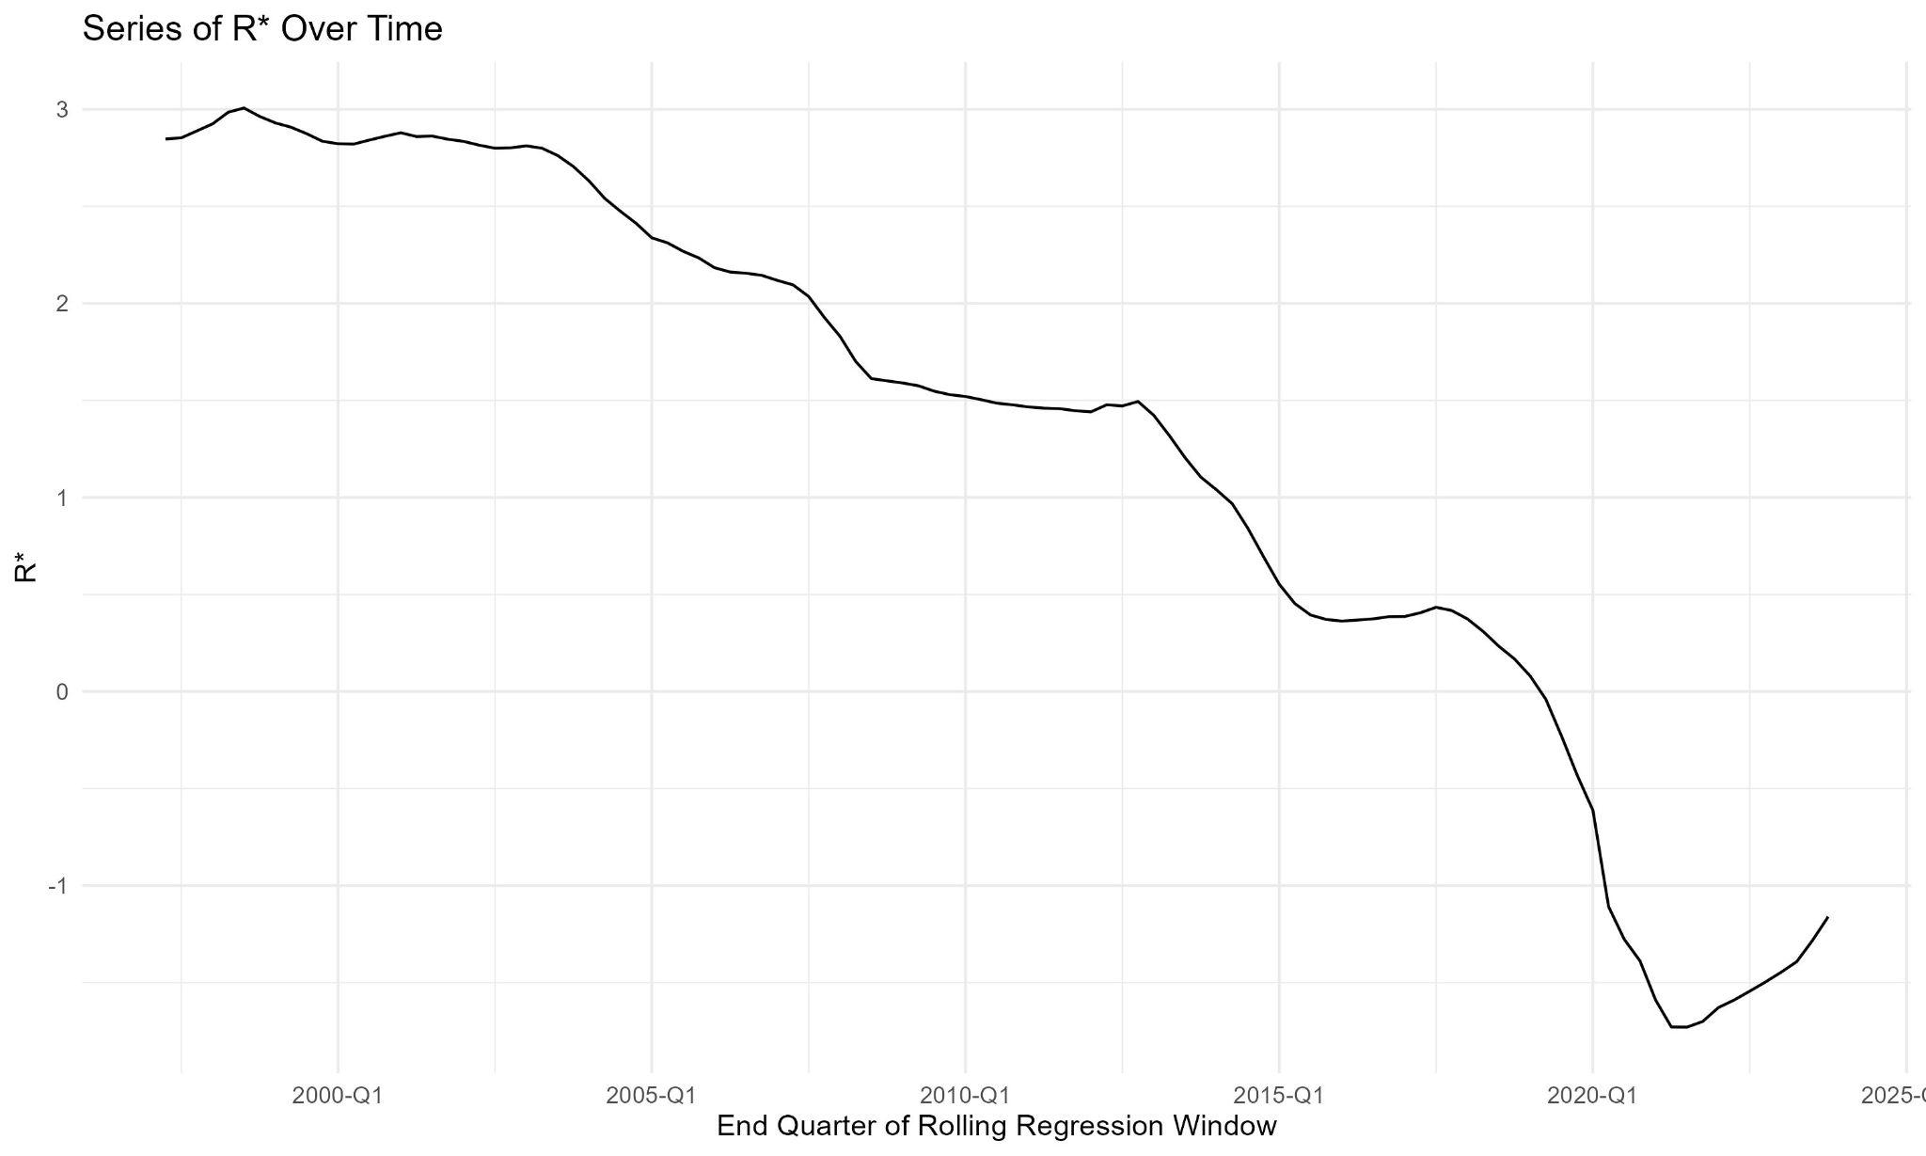

Slide 14
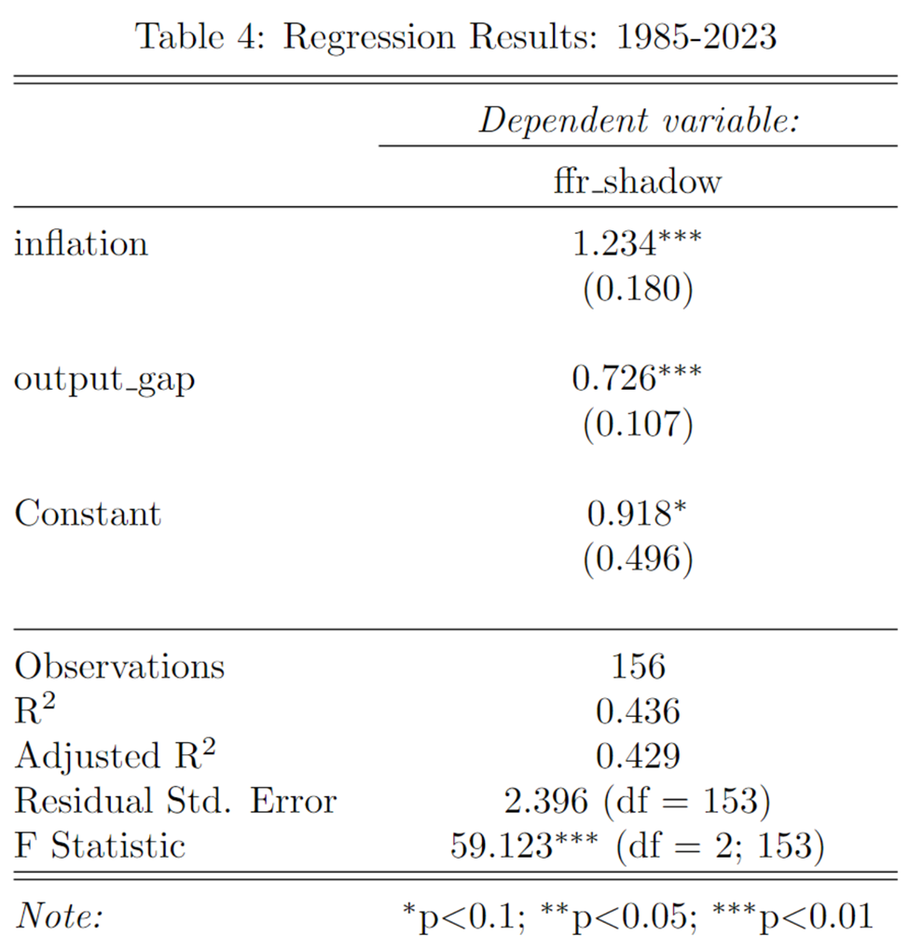
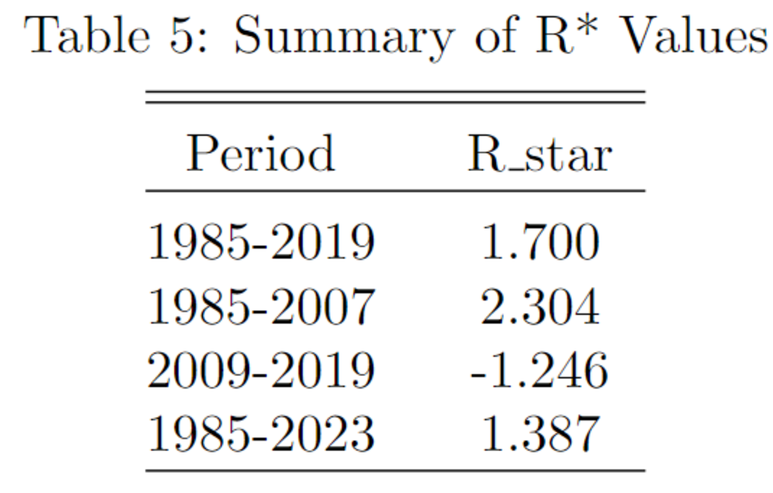

Slide 15
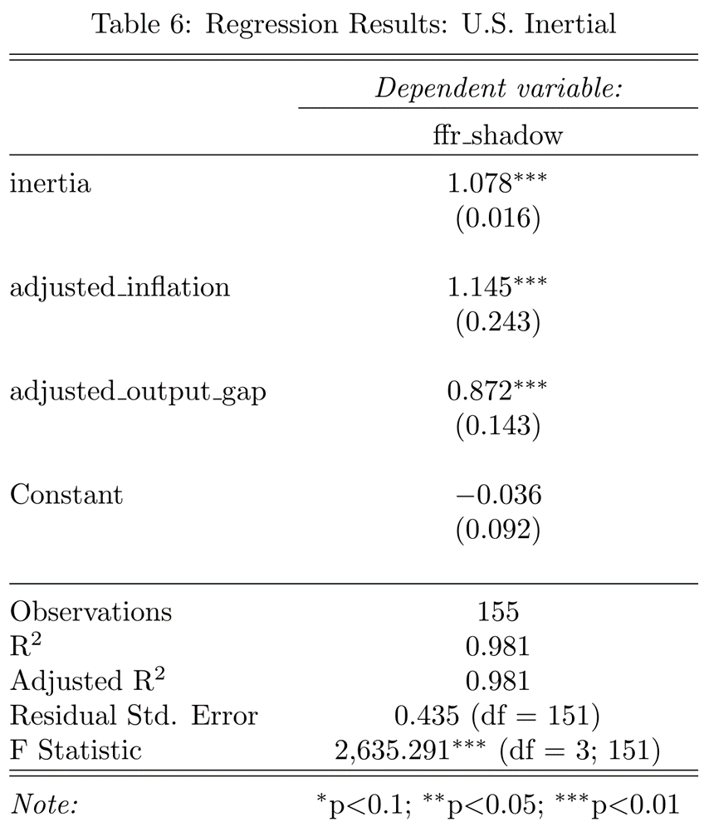
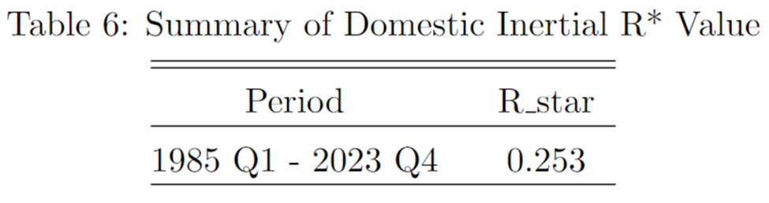
US Results: Inertial Regression

Slide 16
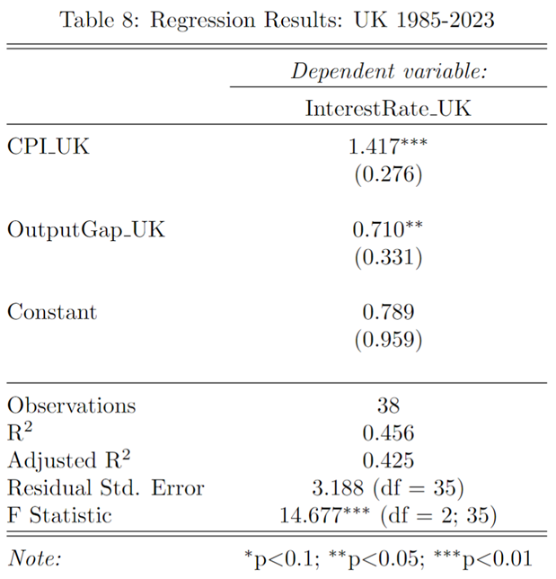
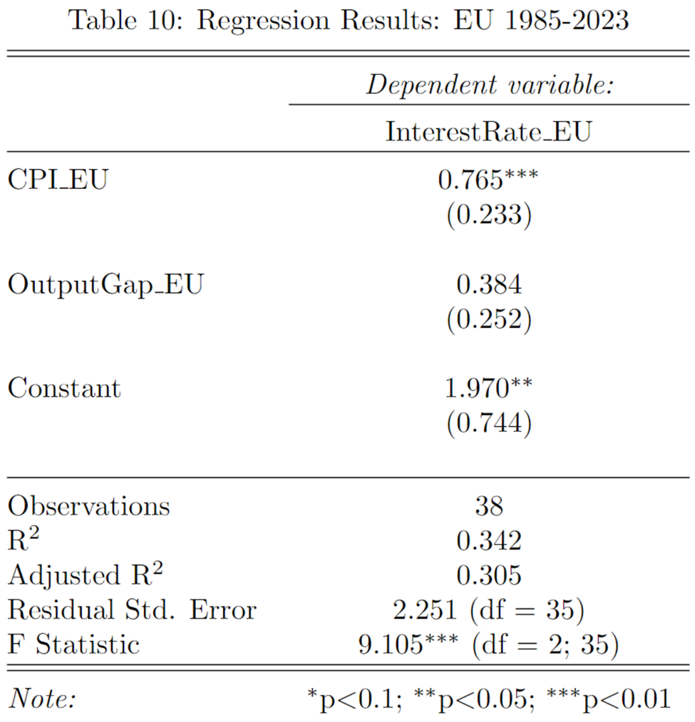
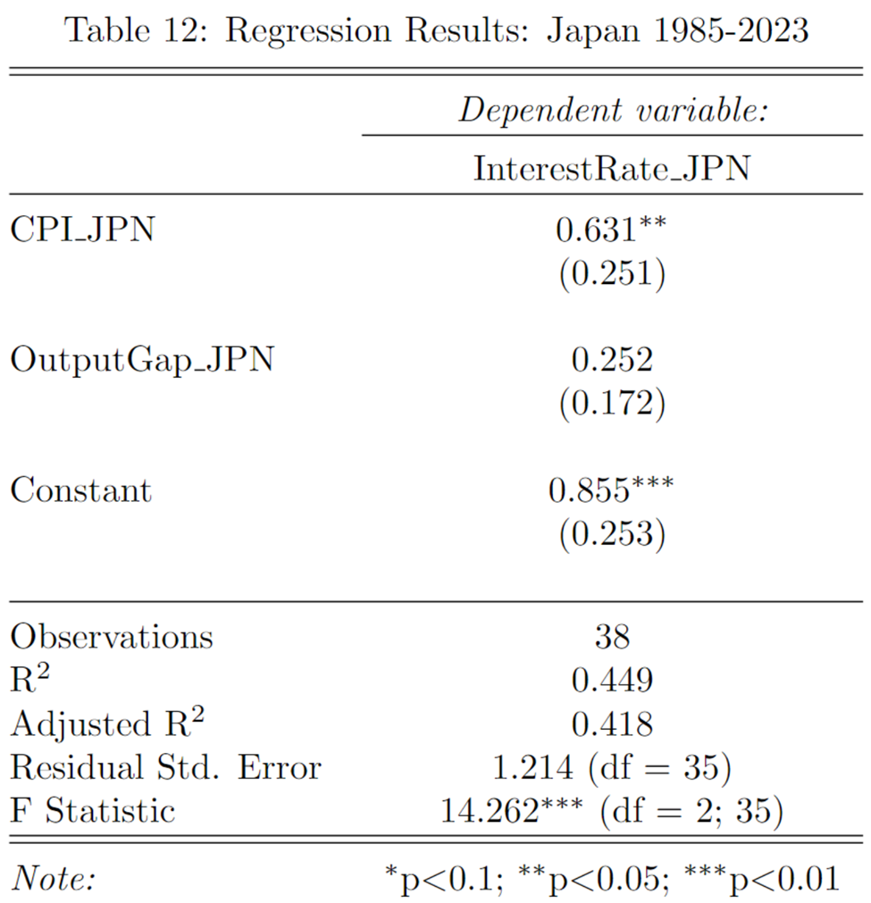
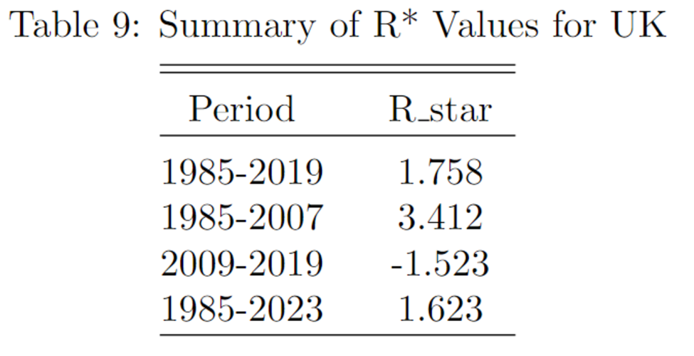
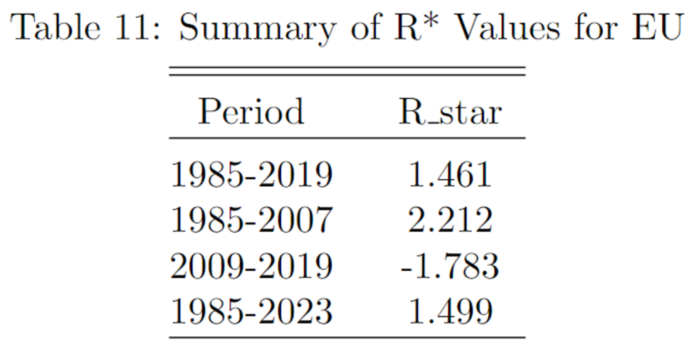
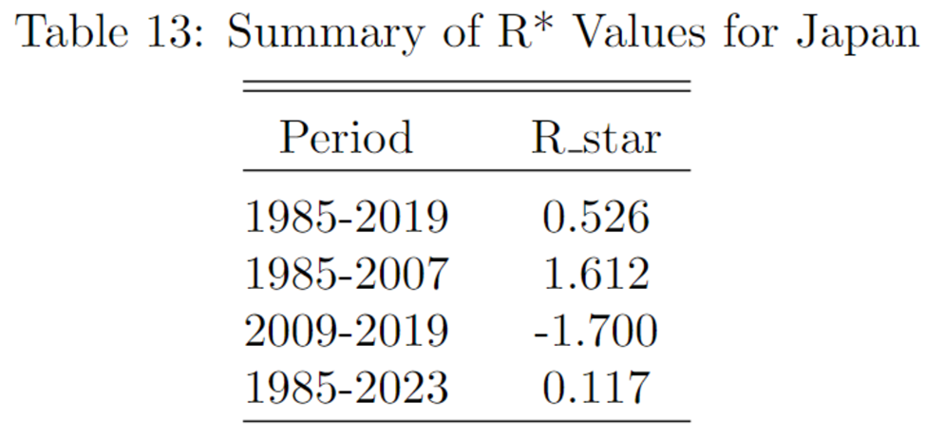
International Results: Simple Regression

Slide 17
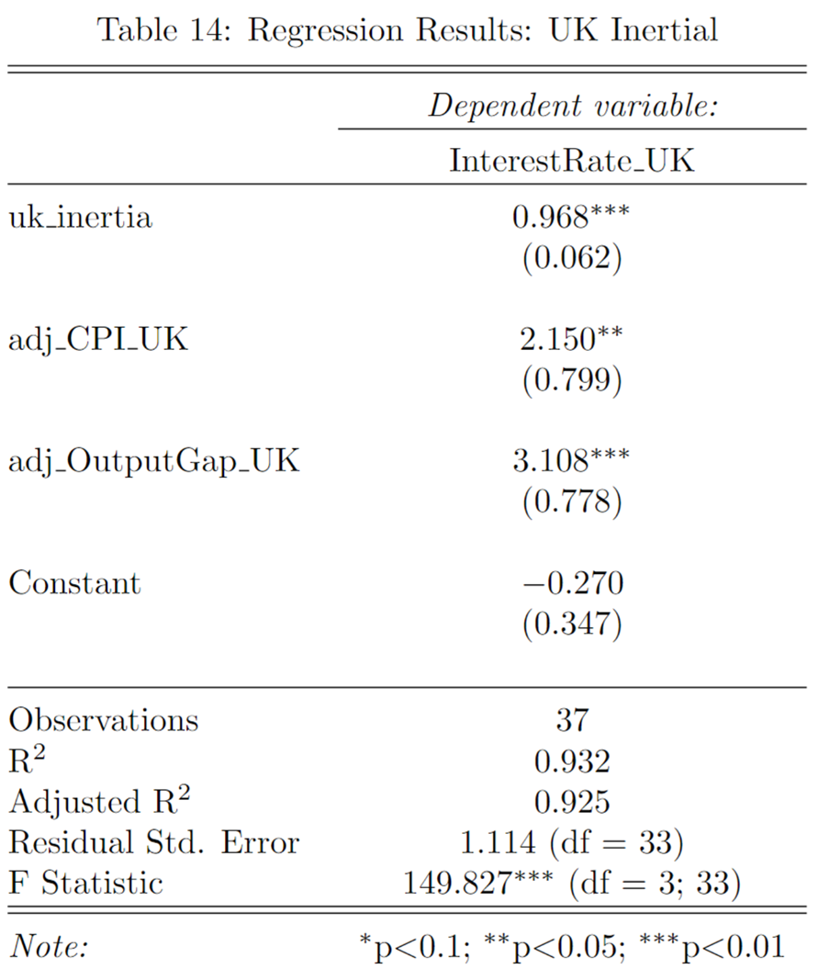
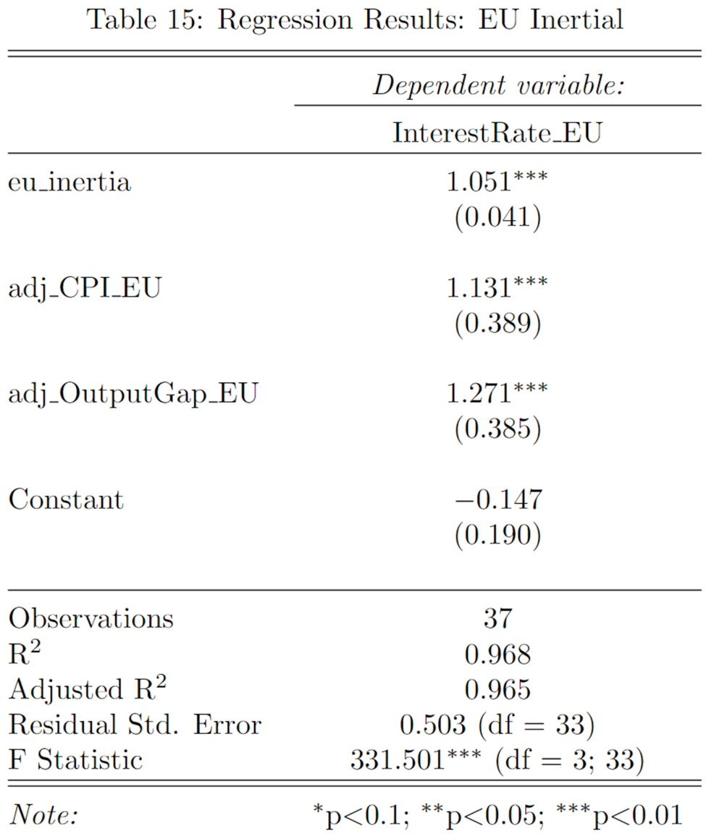
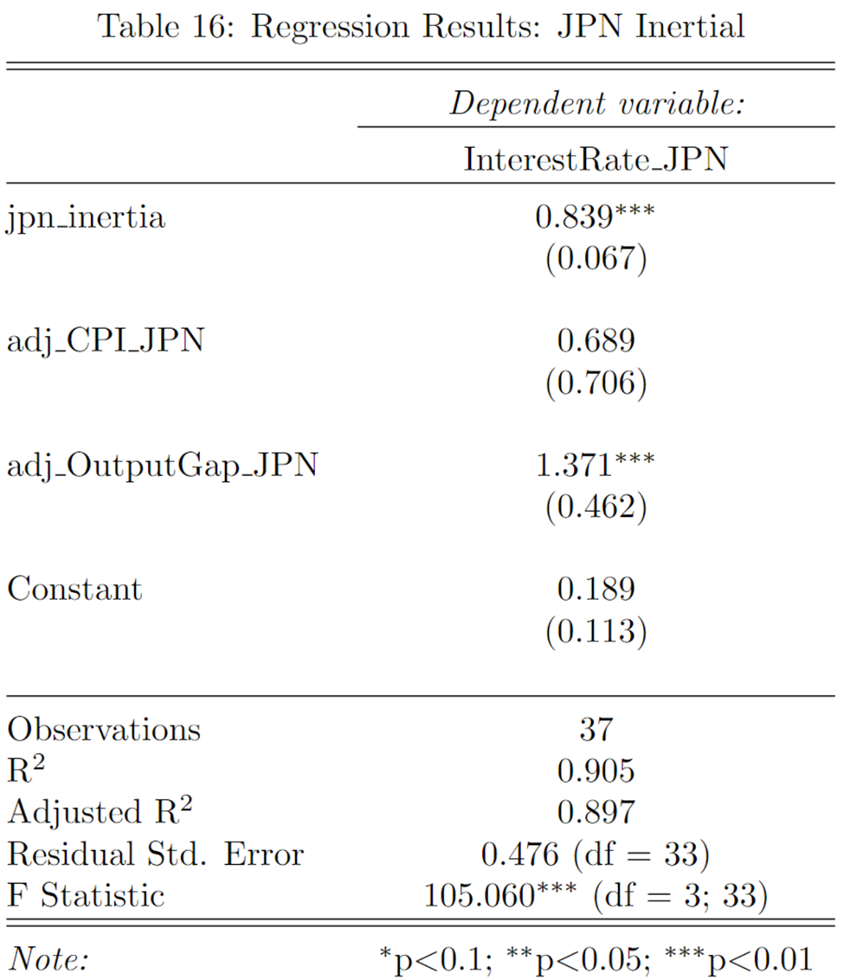
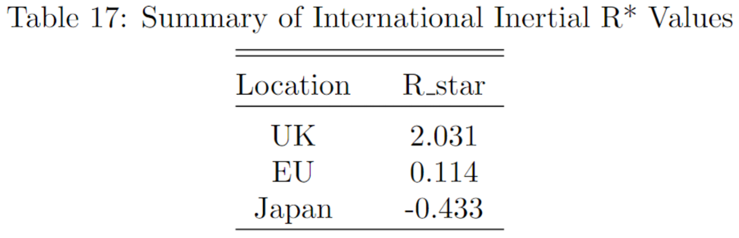
International Results: Inertial Regression

Slide 18
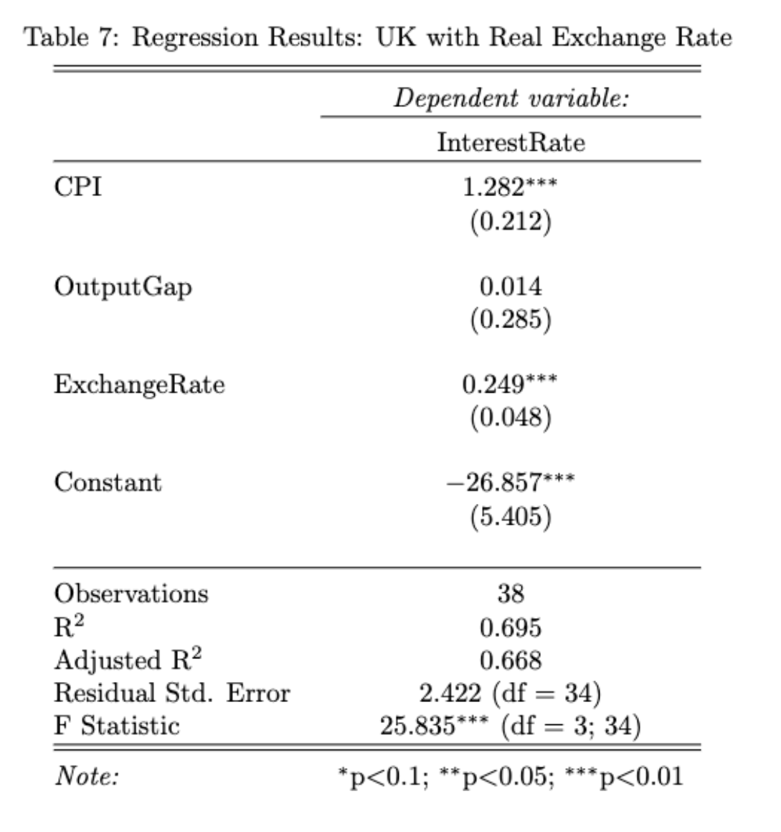
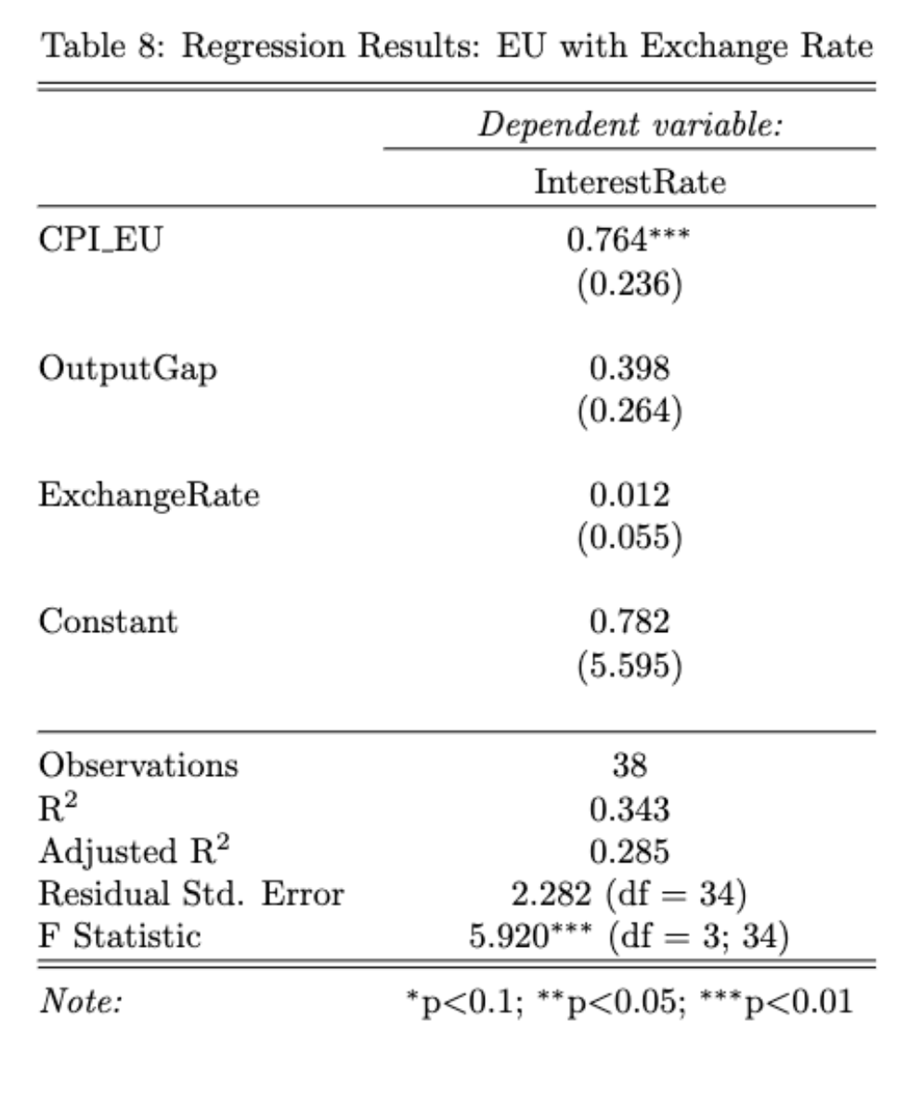
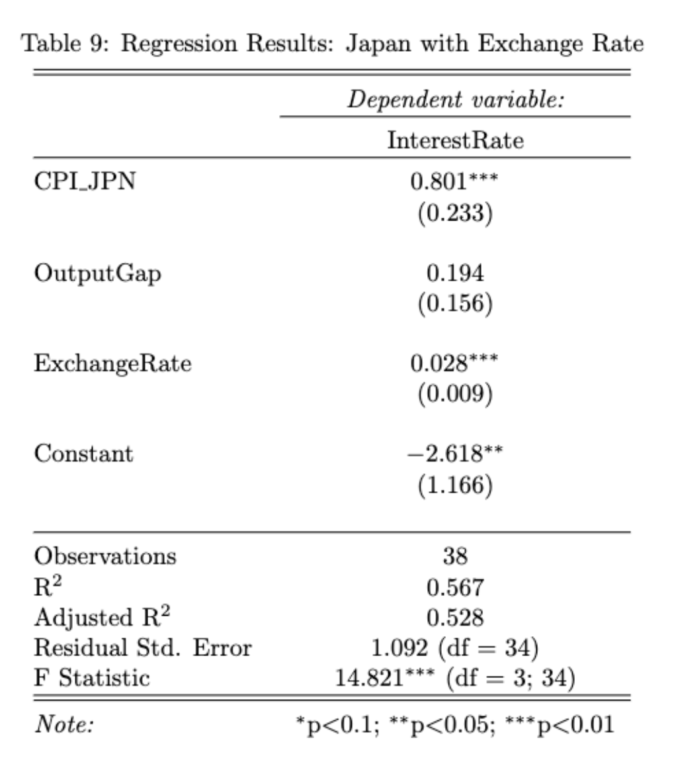
International Results: Real Exchange Rate
Notes:
Real exchange significant for UK, JPN, maybe not EU because it’s a group of countries

Slide 19
Conclusions
Main Findings:
Positive adherence to Taylor Rules
Found a 2% Inflation target
Real Exchange Rate is significant
Recommendation:
Countries should adhere to Taylor Rules
The real exchange rate should be incorporated into policy
Notes:
Our study reinforces the importance of Taylor Rules and the inclusion of real exchange rates, guiding effective monetary policies in complex economic contexts
The key findings were a positive adherence to Taylor Rules
Discovered a 2% inflation target
And the real exchange rate has a significant positive impact
Our recommendation would be
For Countries to Taylor Rules for economic well-being.
Incorporate the real exchange rate in international policy frameworks for enhanced global economic stability.

Slide 20
Questions?
Thank you!

Slide 21
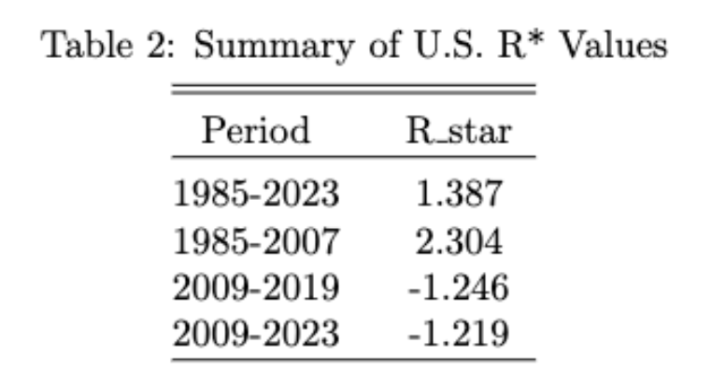
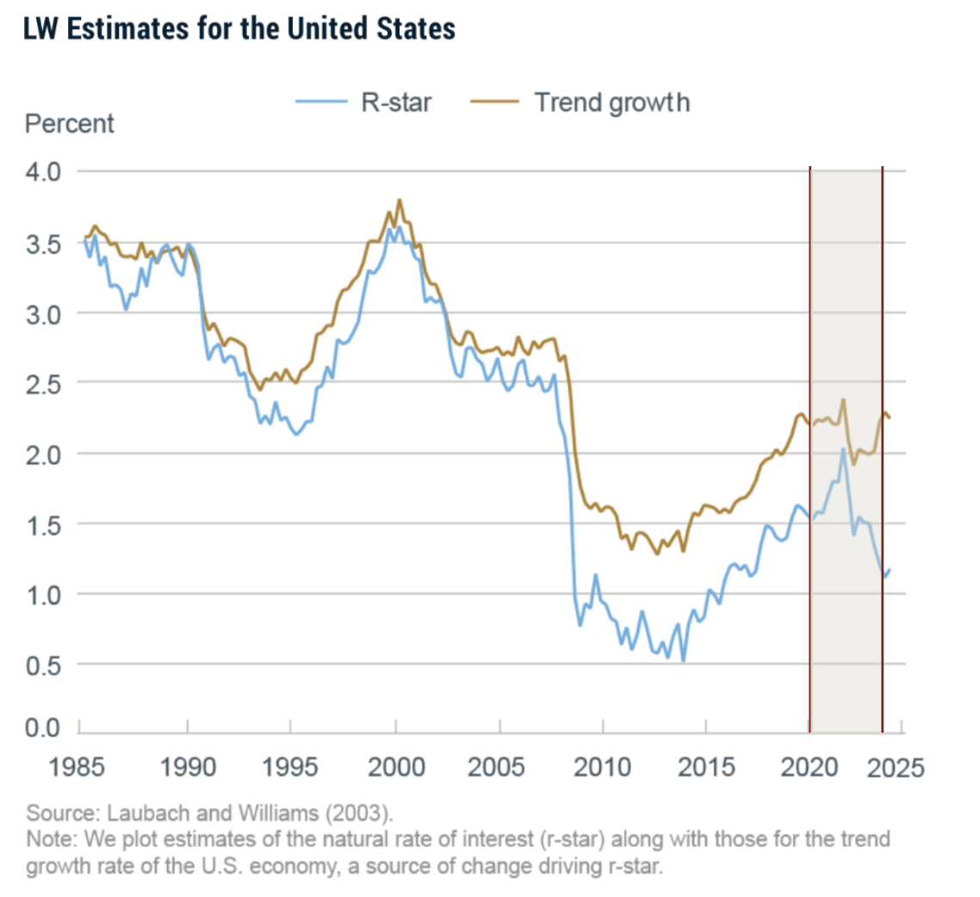
International sector: Using R* to determine the FOMC policy target recommendation
The international sector has seen significant variation in R* over time, as can be seen through the LW model.
Assuming a target inflation of 2%, we find the following R* values:
The declining nature of R* suggests that interest rates will remain low. Given the persistence of inflation, it seems likely that the FOMC will maintain low rates.
We anticipate the rate to remain at 5.25-5.50% given R* trends as well as indications from the last meeting.
Notes:
LW model shows how R* fluctuated significantly over the past few years, ultimately dropping during the pandemic. Whilst it seems like R* was recovering in the first quarter of 2024, it is not sufficient for a trend of increasing R*. Thus, we anticipate that FOMC will remain conservative and keep interest rates low but will not slash them further given the optimism of an increasing R* in 2024.
Further, we also find declining R* values over time from our own project. Whilst we acknowledge the limitation of lacking specificity given the broad range of dates, this still supports the general trend of a low R* which in turn bolsters our recommendation of maintaining the rates at 5.25-5.50%.

